Slide 1
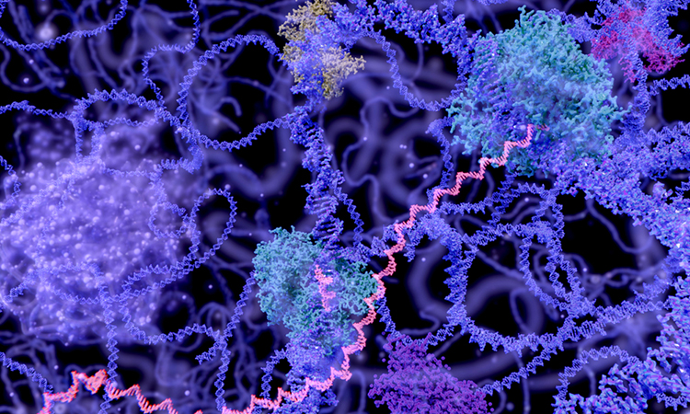
ENZYMATIC PROCESSES IN INDUSTRIAL PRODUCTION AND ITS APPLICATION ENZYME: LACTASE
Name-Rudraksh Sahane
Rol no-02
Div –D
Branch-computer engineering

Slide 2
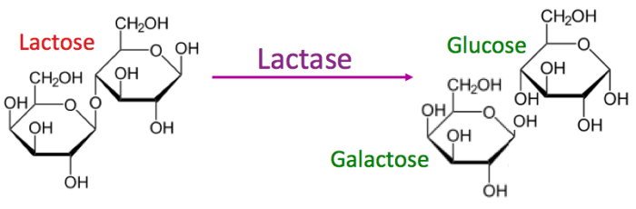
What's lactase
Lactase, enzyme found in the small intestine of mammals that catalyzes the breakdown of lactose (milk sugar) which is disaccharide into simple sugar’s glucose and galactose.
Lactase supplements can be used to treat lactose intolerance.
Lactase is added to dairy, thereby hydrolyzing the lactose in it, leaving it slightly sweet but digestible by everyone

Slide 3
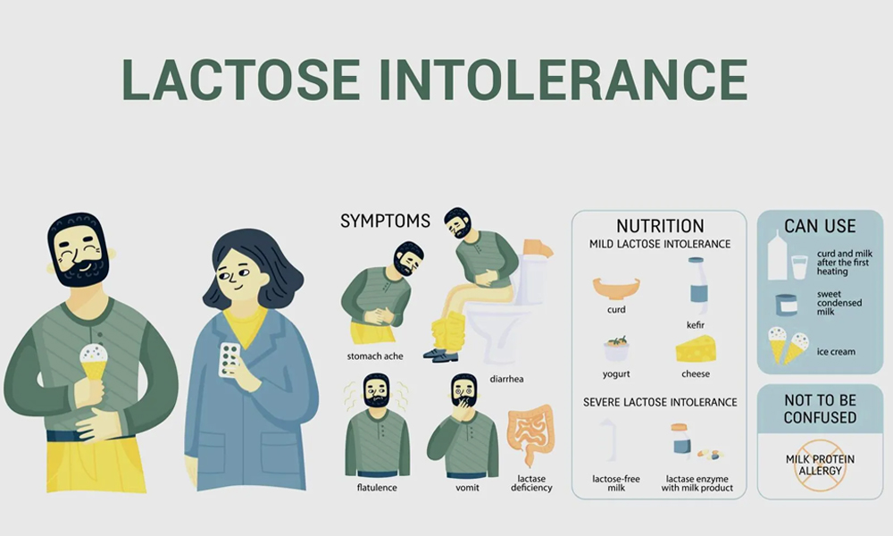
The Challenge: Lactose Intolerance
Lactose is a disaccharide (milk sugar) naturally found in dairy products. Many people, particularly adults, have lactose intolerance, meaning their bodies produce insufficient amounts of the enzyme lactase to break down lactose. When lactose isn't broken down, it can cause digestive discomfort (bloating, gas,diarrhea). This limits dairy consumption for a significant portion of the global population.
Symptoms can appear anywhere from half an hour to two hours after eating a food containing milk or dairy e.g. cheese, yoghurts, cream etc which include vomiting nausea etc.

Slide 4
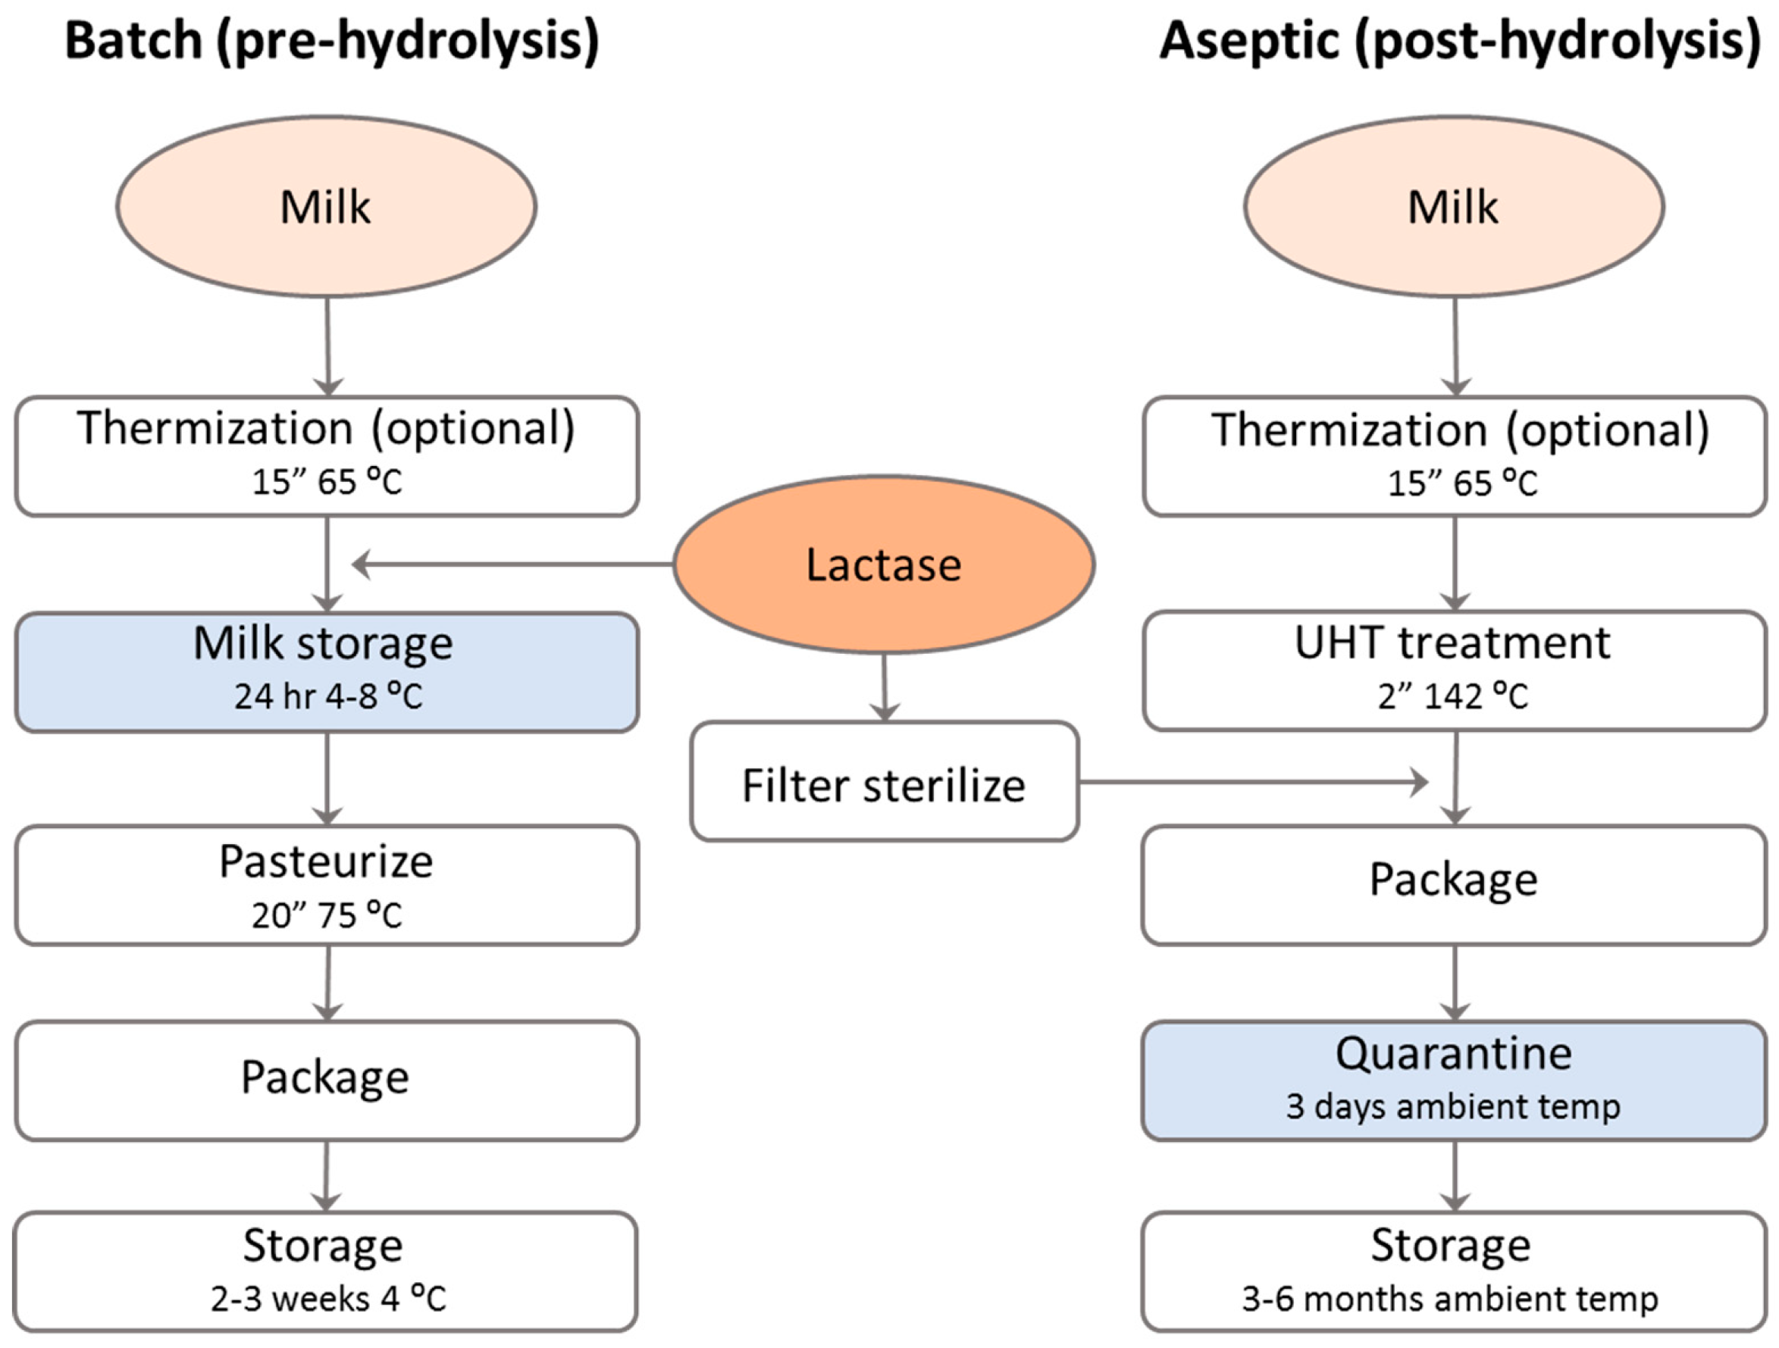
The Industrial Process Flow
1.Raw Milk Collection: Fresh milk is collected and standardized.
2.Enzymatic Treatment: Lactase enzyme is added to the milk.
3.Incubation: The milk is held for several hours under optimal conditions for the
enzyme:
• Temperature: Typically 5−8,
∘ C (for batch processing in refrigeration) or
35−40∘ C (for continuous flow reactors).
• pH: 6.5−7.0 (naturally aligns with milk's pH).
4.Monitoring: The lactose level is monitored until it falls below 0.01-0.1% (the
standard for "lactose-free").
5.Pasteurization & Packaging: The lactose-free milk is then pasteurized (to
inactivate the enzyme and ensure safety) and packaged. For other
products like yogurt or cheese, the lactase treatment might occur at a
different stage, but the principle remains the same.

Slide 5
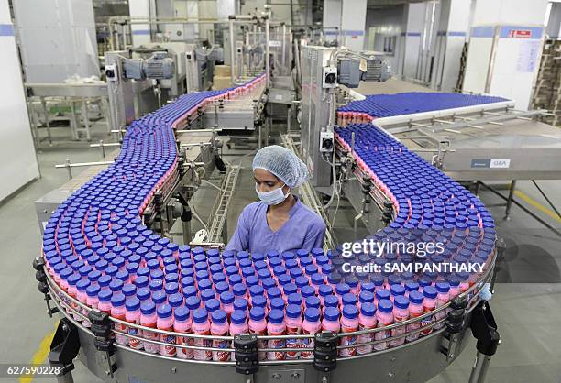
MY ROLE AS An ENGINEER
Engineers can develop smart sensors that scan food products and measure lactase activity or lactate levels. These sensors, when linked with AI, can process the data in real time to give accurate results. This ensures the enzyme is working effectively, maintains product quality, and helps companies create consistent lactose-free products for consumers.
Virtual dairy process testing by making an app to convert maximum amount of lactose into simple sugars thereby preventing diseases to lactose intolerant people

Slide 6
Thank you
Reference websites
https://www.gettyimages.in/photos/amul-milk
https://www.weljii.com/blog/lactose-intolerance/
https://www.britannica.com/science/enzyme
https://www.google.com/?zx=1758350352768&no_sw_cr=1

